Slide 1
Markov Chain Image Generation
Matthew Yu
October 2019
Notes:
October 10, 2019 TI

Slide 2
About Me
Junior level student in UT ECE
Actively interested in robotics, rockets, and embedded systems
Member of multiple organizations, including:
IEEE Robotics and Automation Society
UT Solar Vehicles Team
UT Socially Intelligent Machines Lab
Texas Rocket Engineering Lab
American Society of Mechanical Engineers
Interned Summer 2019 for Cisco in Software Engineering
Notes:
20 seconds

Slide 3
Outline
A Brief Context
What are Markov Chains?
Problem Layout
Building an Image Generator
Results
Further Research and Extension
Notes:
End at 1 minute worst case

Slide 4

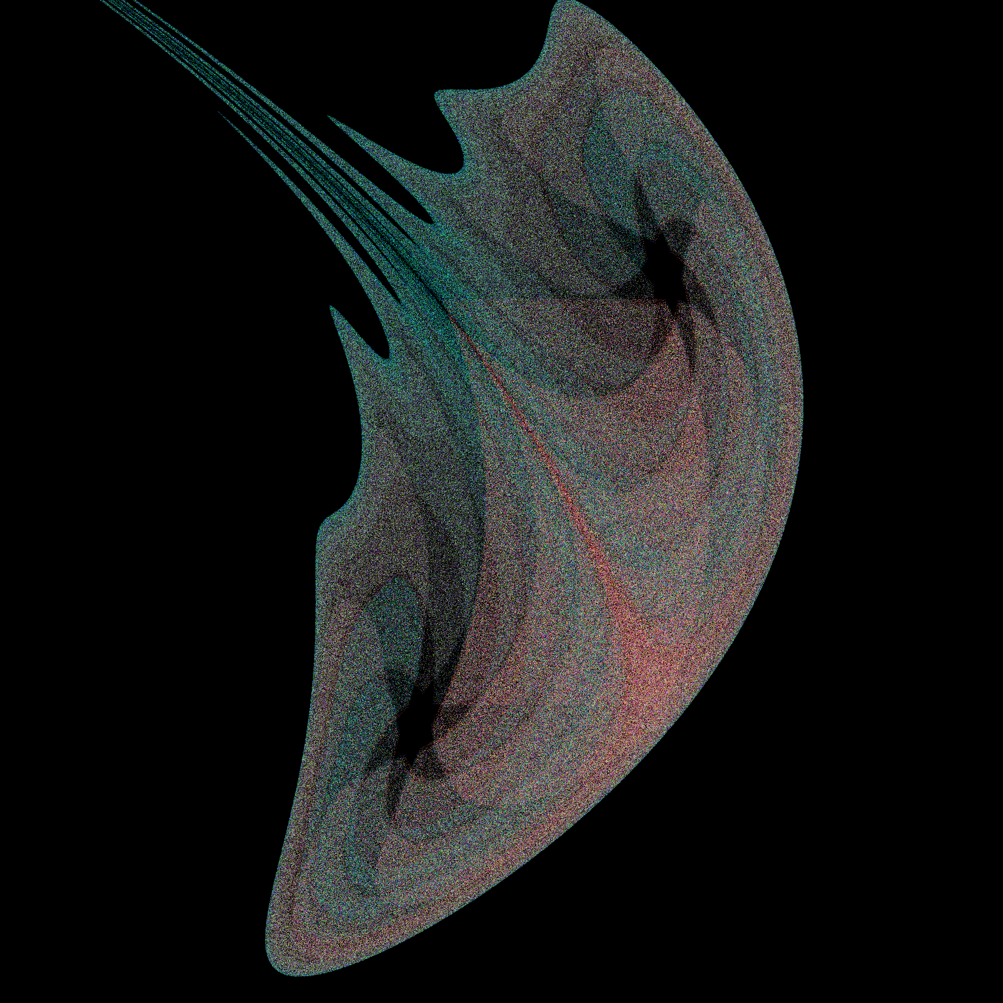
A Brief Context
Motivations
I create Generative Art as a hobby
Stochastic Processes in M340L (Random Walks)
Recent use of ML to generate realistic art
Timeline
January – May 2019 and ongoing
Problem Statement:
How can I use probability to generate images?
Untitled. (Yu, 2018).
Notes:
End at 1:45 worst case

Slide 5
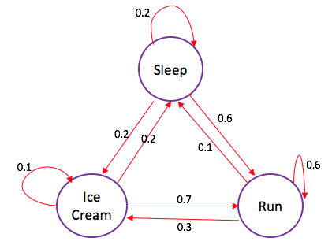
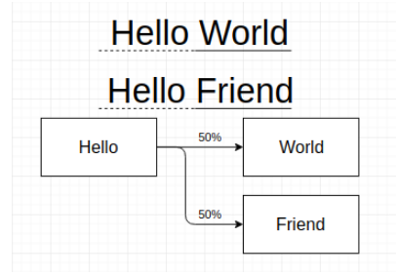
What are Markov Chains?
A probabilistic model of the world
Similar to Moore finite state machines
Used with big data sets to predict outcomes
Applications include:
PageRank (Google)
National Novel Generation Month (NaNoGenMo)
Procedural Game Generation (Mario Bros.)
Figure 1. Markov Chain depicted as a state diagram. (Jaiswal, 2018).
Figure 2. Construction of a Markov Chain from two phrases. (Yu, 2019).
Notes:
End at 3:00 worst case

Slide 6

Problem Layout
What data should I use?
01
How should I store the data?
02
How can I use this data to build my model?
03
Notes:
End at 3:30 worst case

Slide 7
Building an Image Generator
Requirements:
RGB Pixel data of each image
Easy to get
Fits well in the space
2-dimensional array structure
X: current state
Y: next state
Matrix[X][Y] : probability of going from X to Y
Functions:
Building the Markov Chain
Getting the next state from the Markov Chain
Y
.5 | .7
.5 | .3
1
Probability of next pixel
0
X
0
1
Index of current pixel
Figure 3. A stochastic matrix represented as an array. (Yu, 2019).
Notes:
End at 4:30 worst case

Slide 8
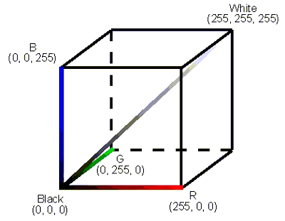
Building an Image Generator
What does a pixel consist of?
Red, Green, Blue (RGB) color data
Each part ranges from 0-255
256 ^ 3 > 10 million possible colors for the X axis alone
That’s a lot!
Need to reduce the color space
Color Quantization
Figure 4. RGB Color Space. (Basler, n.d.)
Notes:
Skip if at 5 min

Slide 9
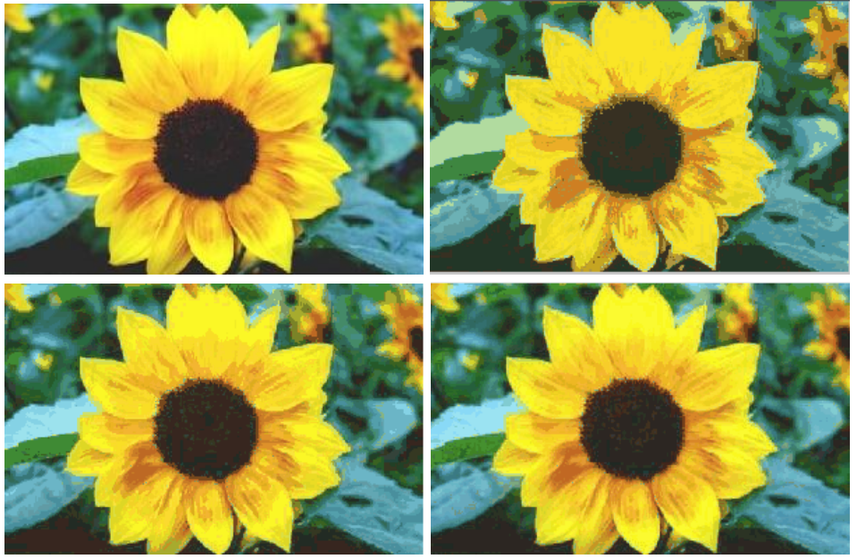
Building an Image Generator
Color Quantization
Reducing the color space
Modified bucket sort
Each bucket has a capacity and bounding space (RGB)
If a bucket is full, split it in half
Median cut algorithm along the longest axis
Ability to merge buckets
Can achieve order of 10 states instead of 10 million states
Figure 5. Sunflowers at different color depths. (Fei Fei, 2004, modified 2019 by Matthew Yu).
Top: (Left) original, (Right) 20 colors,
Bottom: (Left) 47 colors, (Right) 93 colors
Notes:
Skip if at 5:30 minutes

Slide 10
Building an Image Generator
2-Dimensional Array
X, Y index is the pixel color encoding
Y[n] = occurrences of next color given X[m] current color
Advantages
O(1) access compared to linked lists O(n)
Disadvantages
O(n^2) space complexity
Images are sparse – most space is wasted
Y
.5 | .7
.5 | .3
1
Probability of next pixel
0
X
0
1
Index of current pixel
Figure 3. A stochastic matrix represented as an array. (Yu, 2019).
Where 0 – black, 1 – white
Notes:
6:30 worst case

Slide 11
Building an Image Generator
Building the Markov Chain
Given the current and next pixel:
Find the current bucket (X) and next bucket (Y)
Add an occurrence at (X, Y)
Markov_chain[current_bucket][next_bucket]++;
Generating an Image from the Markov Chain
Given your current pixel:
Find the current bucket (X)
Get sum occurrences at (X, all Y)
Roll a number k in range (0, sum_occurrences]
Find the bucket index that corresponds to the kth occurrence, sequentially
This bucket index corresponds to the color of your next pixel
Repeat for n pixels, where the next pixel becomes the current pixel after each iteration.
Notes:
7:30 worst case

Slide 12

Results

Slide 13
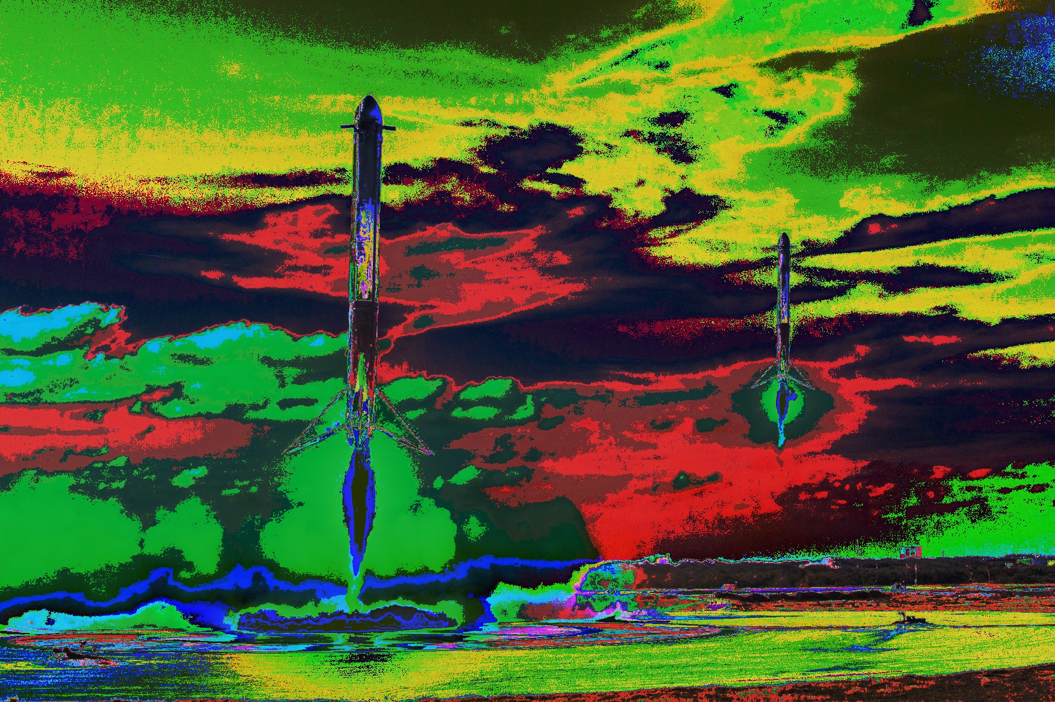
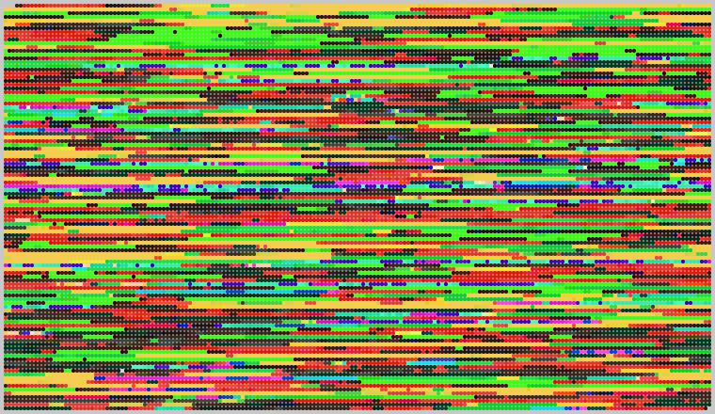
Falcon Heavy Booster Landing, Recolorized (2018)
1st Order Markov Chain Result
SpaceX, (Feb 2018). Modified Oct 2018 by my Noisy program.
Untitled, (Yu 2019).
Notes:
8:00 min worst case

Slide 14
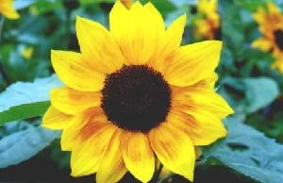
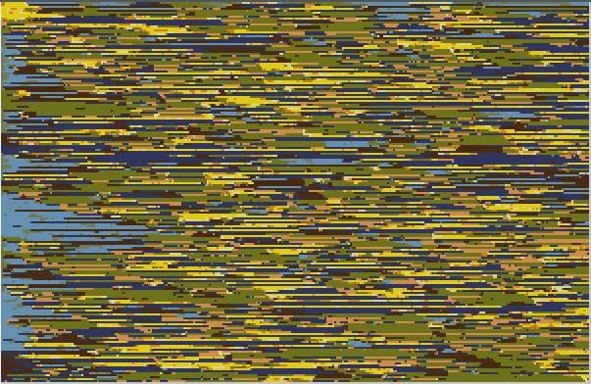
Sunflower Data Set from Caltech (85 Images)
2nd Order Markov Chain Result
L. Fei-Fei, R. Fergus and P. Perona. Learning generative visual models from few training examples: an incremental Bayesian approach tested on 101 object categories. IEEE. CVPR 2004, Workshop on Generative-Model Based Vision. 2004
Untitled, (Yu 2019).
Notes:
8 30 worst case

Slide 15
Results
Limitations:
Lack of output complexity
Requires higher order Markov Chains
Data structure sparseness
Majority of the matrix has no occurrences
More so on higher order Markov Chains
Data structure space complexity
O(n^k), n – number of colors, k – order (how many inputs)
Currently only works on (X, Y, Z) point types - (R, G, B)
Notes:
9:15 worst case

Slide 16
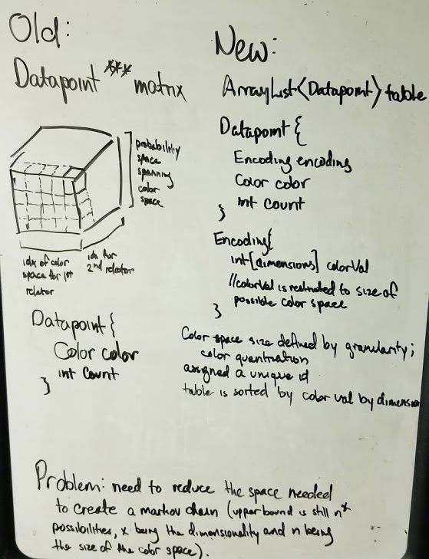
Further Research and Extension
Iterative function optimization
Hundreds of seconds to tens of seconds
Higher order Markov Chains
Moving from N-dimensional array to vectors
Accommodating higher-dimensionality sparseness
Generifying functions for Datapoint types
Images
Sound
Words
Notes:
10 worst case

Slide 17
References
Jaiswal, S. (2018, May 1). Python Markov Chains Beginner Tutorial. Retrieved October 8, 2019, from https://www.datacamp.com/community/tutorials/markov-chains-python-tutorial.
What is the RGB color space? (n.d.). Retrieved October 9, 2019, from https://www.baslerweb.com/en/sales-support/knowledge-base/frequently-asked-questions/what-is-the-rgb-color-space/15179/.
L. Fei-Fei, R. Fergus and P. Perona. Learning generative visual models from few training examples: an incremental Bayesian approach tested on 101 object categories. IEEE. CVPR 2004, Workshop on Generative-Model Based Vision. 2004
Anderson, W. (2017, May 10). Using Machine Learning to Make Art. Retrieved October 8, 2019, from https://magenta.as/using-machine-learning-to-make-art-84df7d3bb911.

